Slide 1
The Transport Layer
CPSC 3600

Slide 2
Updates for Part 1 survey
Scrapping the idea of a review after test, most students felt too drained by the test to get much out of it
Will experiment with a video lecture where I work through and explain the answers that will be posted after the exam
Will try and provide more sample problems with answers
There will also be more homework in the second part of the class, with answers posted after submission

Slide 3
Updates about project
“Run on your personal computer”
“Handle two types of responses”
If you get an OK message, fetch the file
Otherwise, don’t do anything

Slide 4
Planned Schedule for Module 2
Ch 3.1 - 3.2
Ch 3.3 - 3.4.1
Ch 3.4.1 - 3.4.2
Ch 3.4.3 - 3.4.4
Ch 3.5 - 3.5.3
Ch 3.5.4 - 3.5.5
Ch 3.5.6 - Ch 3.6
Ch 3.7
Review

Slide 5
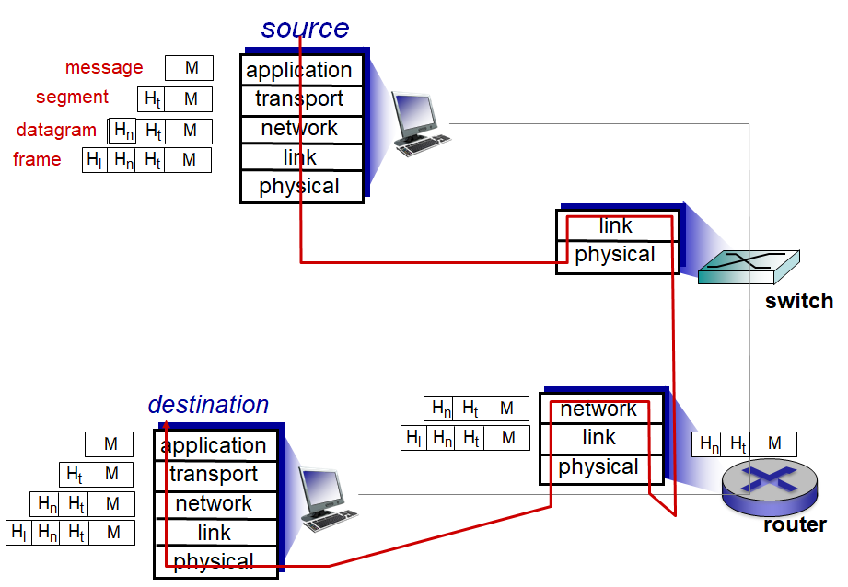

Slide 6
What is the transport layer?
Link layer = transport between adjacent network elements
Network layer = transport between hosts/end points
Transport layer = transport between processes
Logical communication
Transport layer doesn’t actually connect directly to other process, but it seems like it does from the transport layer’s perspective

Slide 7
What is the transport layer?
Transport protocols run on end systems, not on routers
Sending: break data from apps into segments, pass to network layer
Receiving: reassemble segments into messages, pass to apps
Two transport protocols on the Internet
TCP
UDP

Slide 8
Example
Two homes (Ann & Bill), each with 12 kids
Two end systems, running 12 processes each
Kids in each home send letters to kids in the other home
Messages passing over the internet, via packets
Ann & Bill are responsible for:
Collecting letters and putting them in the mailbox
Gathering letters from the mailbox and giving them to the kids

Slide 9
Example
From the kids perspective, Ann and Bill ARE the postal service, but they’re really only a part of it
Ann & Bill can provide different services, just like Transport protocols provide different services:
Pick up & deliver letters at different rates
Potentially lose letters
…

Slide 10
Example
Services provided by Ann and Bill are constrained by the underlying services provided by the mail service
If the mail service makes no guarantees about minimum delivery time, then neither can Ann or Bill
However, Ann & Bill can guarantee some services that are not provided by the mail service
E.g. TCP provides reliable data transfer, even though the Network layer does not

Slide 11
Services Provided
UDP offers unreliable, unordered delivery
No-frills best extension of “best-effort” IP protocol
Minimal error checking
TCP offers reliable, in-order delivery
Guarantees packets will arrive… eventually
Guarantees packet integrity (data isn’t corrupted)
Packets delivered in the correct order
Provides congestion and flow control
Both provide transport-layer multiplexing & demultiplexing
This is the fundamental service provided by transport protocols

Slide 12
Get with a neighbor and discuss TCP and UDP in terms of the Alice and Bob example.
Map the different pieces of the example (e.g. kids, letters, houses, postal service, etc) onto the Internet’s protocol layers.
Where can delivery of the letters go wrong?
How can Alice and Bob make sure the letters are transmitted & received reliably even those the post office can’t guarantee it?

Slide 13
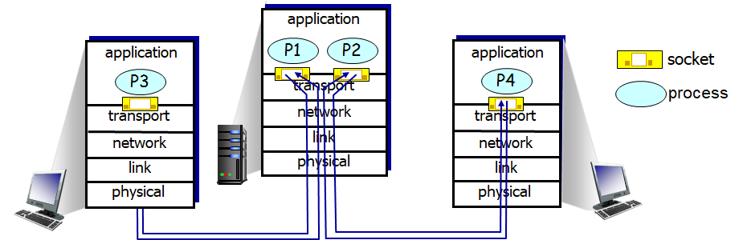
Multiplexing & Demultiplexing
Contains fields for source & destination port
Multiplexing at sender
Take data from sockets, add transport header, send to transport layer
Demultiplexing at receiver
Use transport header to deliver to the correct socket

Slide 14
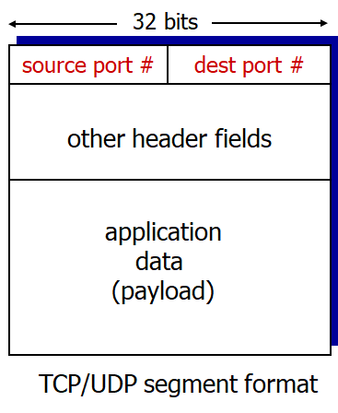
Reminder: Transport Header
Transport layer adds/removes port information
Network layer adds/removes IP address information
Host uses both of these pieces of data to send to appropriate socket/process

Slide 15
Multiplexing
Skype
Transport Layer
Chrome
Network Layer
Encapsulate data into segments
Add Transport layer header with source + dest ports
Games
BitTorrent

Slide 16
Demultiplexing
Skype
Transport Layer
Extract dest port from transport header, send to process requesting data from that port
Chrome
Network Layer
Read segments from network layer
Games
BitTorrent

Slide 17
UDP Sockets
When a UDP socket is created it is assigned to a random port not currently in use for UDP
It can then be bound to a specific port, if desired
sock = socket(AF_INET, SOCK_DGRAM)
sock.bind((‘ ’, desired_port_num))

Slide 18
UDP Sockets
When sending a packet through the socket, the transport header is appended to it
Contains two important values for us: source port, dest port
Source port = the port this socket is bound to
Automatically determined
Dest port = the port the receiving process is listening on
Specified by program/user
sock.sendto(message.encode(), (serverName, serverPort))

Slide 19
UDP Sockets
UDP sockets are fully defined as: (dest_addr, dest_port)
However, we need to include source_port in the header because this allows for a response to the original sender
If two clients both send to the same (dest_addr, dest_port), both clients’ data will be sent to the same process
message, clientAddress = udpServer.recvfrom(2048)
newMessage = message.decode().upper()
udpServer.sendto(newMessage.encode(), clientAddress)

Slide 20
TCP Sockets
TCP adds some additional complexity, because it is connection-oriented
Unlike UDP, TCP is defined with a four-tuple
(source_addr, source_port, dest_addr, dest_port)
All of this information is used when demuxing TCP data
This is how each client is directed to its own unique socket

Slide 21
TCP Sockets
TCP server has a “welcoming socket” waiting for connection requests
TCP client creates a socket and sends a connection request to the server
tcpServer = socket(AF_INET, SOCK_STREAM) tcpServer.bind((‘’, my_server_port)) tcpServer.listen()
tcpClient = socket(AF_INET, SOCK_STREAM) tcpClient.connect((serverIP, my_server_port))

Slide 22
TCP Sockets
When client creates the socket, it sends a connection establishment request to the server.
This is just a TCP segment with the destination port and the connection-establishment bitflag set
The server notes this request and creates a new socket, which is assigned to a random, unused port
connectionSocket, addr = tcpServer.accept()

Slide 23
TCP Sockets
The transport layer makes a note of this new port and maps the TCP socket (client_addr, client_port, dest_addr, dest_port) to the port assigned to the new socket
Think of it as a forwarding address for email
Unlike UDP, if two different clients send data to (dest_addr, dest_port), both will get directed to different sockets

Slide 24
Compute how long it will take to download a web page of the following description using a non-persistent connection. Report results in seconds
1 web page (100 Kb), includes 10 images (1 Mb each)
2 seconds to travel to server and back (RTT)
NO parallel connections
1 Mbps symmetric link connects client and server
Assume transmission time for packets from client is negligible
Notes:
Total d_trans = 10.1 Mb/1Mbps = 10.1 seconds
11 connections to server needed, in serial = 11 * 2RTT = 44 seconds
Total = 54.1 seconds

Slide 25
Before Next Class
Read Section 3.1 - 3.4.1 (this + next class’ material)
Complete HW 2.1
Finish Web Client and Server assignments, due on 10/1

